Slide 1

Team 2
akunaMatata

Slide 2
PROJECT: TOUR TRAVEL
TEAM2:
Kiều Minh Tuấn
Huỳnh Thị Tuyết Ngọc
Nguyễn Đức Mạnh
Phạm nguyên Bảo
Trần Hải Vân

Slide 3
Division | Contents
1.Service | Offers tours that include hotels, transportation, and visits to famous sites.
2. Background | The desire to explore and enjoy everyone's famous places
3. Planning purpose | Make it convenient to visit or rest and don't need to worry about costs and accommodation.
4. Benefit | There will be many people using the service, increasing the company's revenue from 0-> 20%
5. Main function | Login Book a tour (including hotel, transportation) Search Blog(like, cmt) Admin(statistics, manage) Payment
6. Key customers | Everybody
7. Service chanel | Web
8. Other(open time) | 23/7/2021

Slide 4
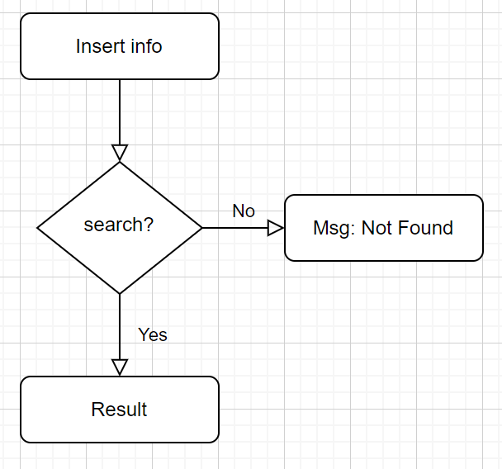
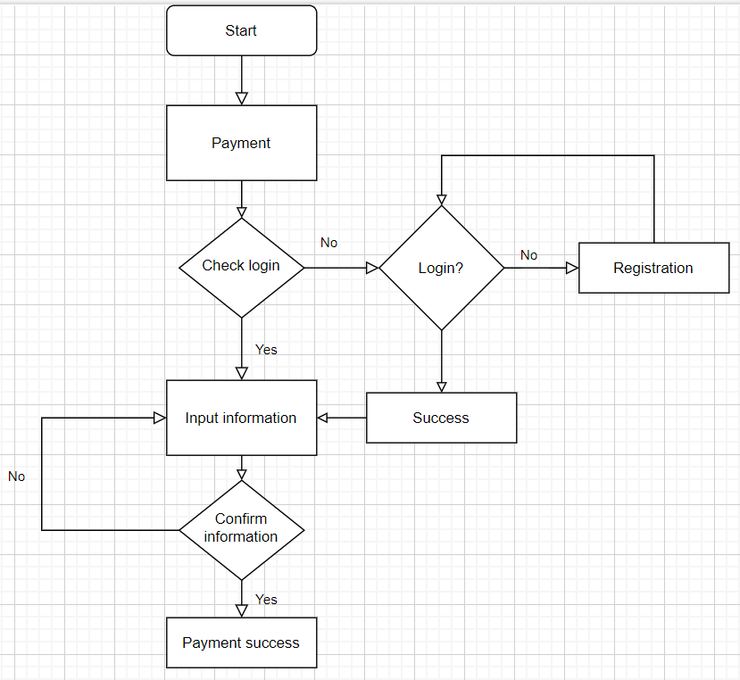
FLOW CHART
Search
Payment

Slide 5
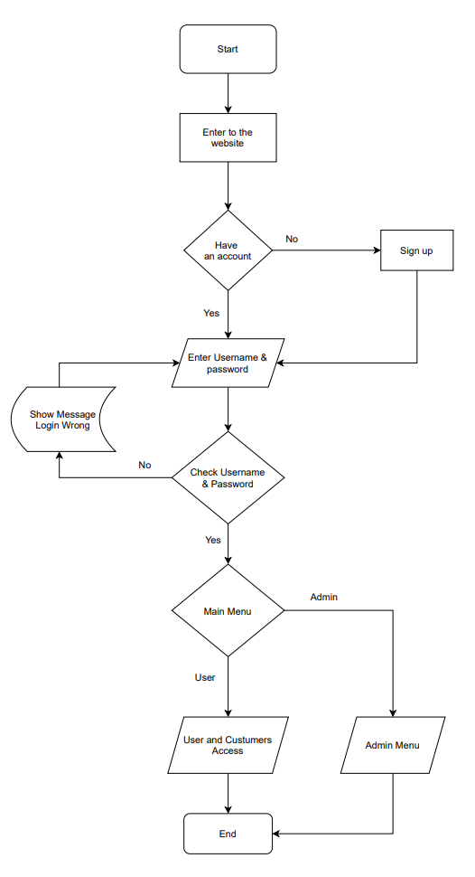
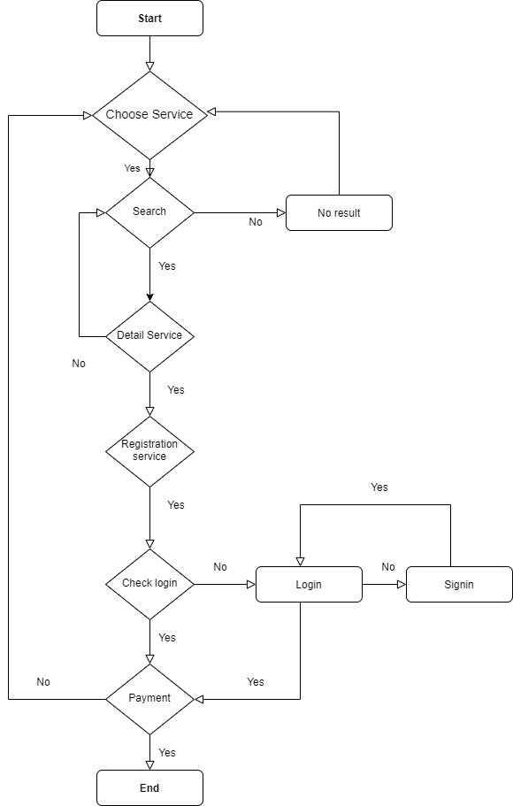
Book Tour
Login

Slide 6
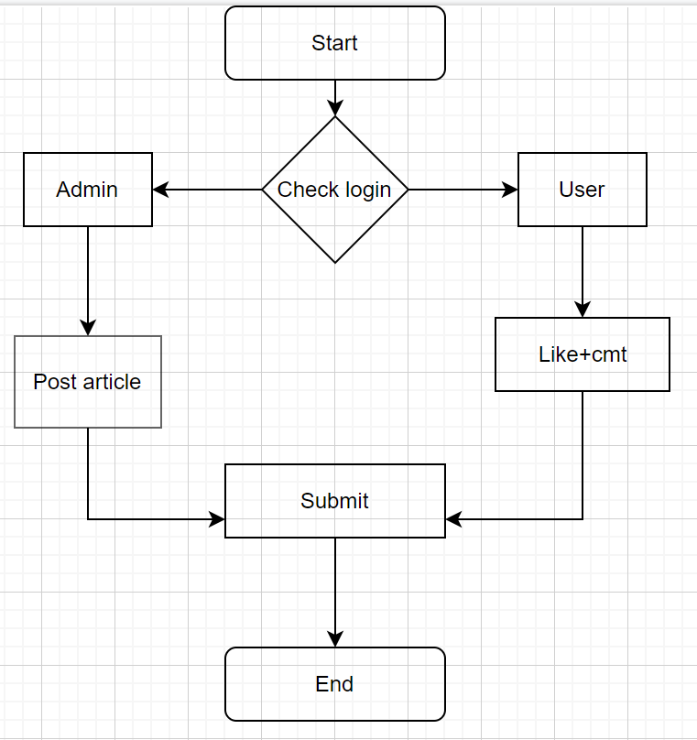
Blog

Slide 7
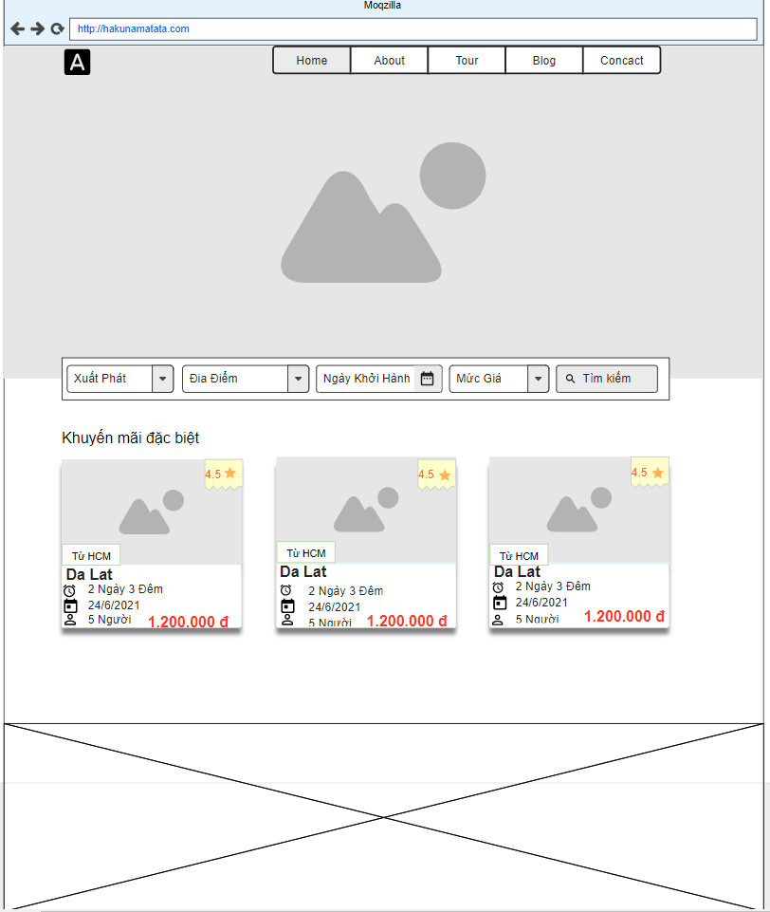
STORY BOARD
No | Description
1 | Search bar, if click search-> redirect: search
2 | Tour good, discount
No | Table
1. Xuất phát | department
2. địa điểm | Province
3. | Tour
1
2
Home

Slide 8
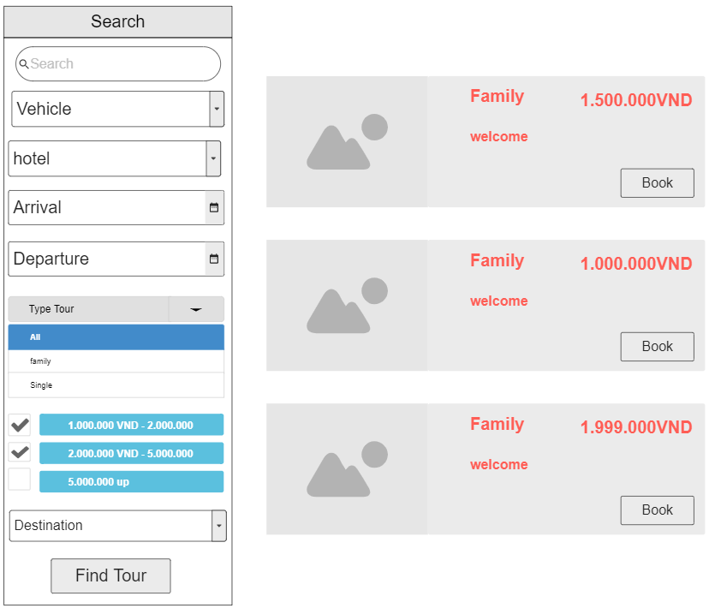
7
No | Description
1 | Input text to want search
2 | Start day of tour
3 | End day of tour
4 | Type tour
5 | Price of tour
6 | Destination
7 | View tour after search
8 | Click button after choose option
9 | Image
10 | Name tour
11 | Description of tour
12 | Click button-> redirect: book tour
13 | Transport
14 | Hotel type
1
9
10
13
11
14
12
2
3
4
5
6
8
Search

Slide 9
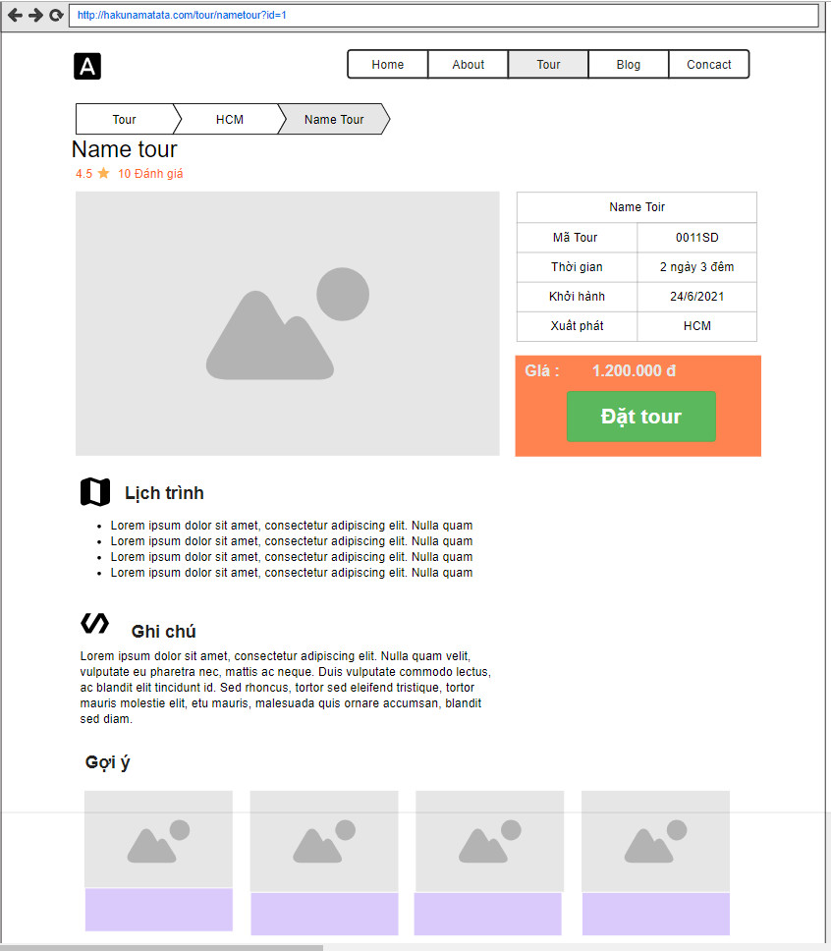
No | Description
1 | Details tour
2 | Click -> redirect: book tour
3 | Recommend tour
4 | Schedule
5 | Note
2
1
4
No | Table
1. | Tour
5
3
Tour detail

Slide 10
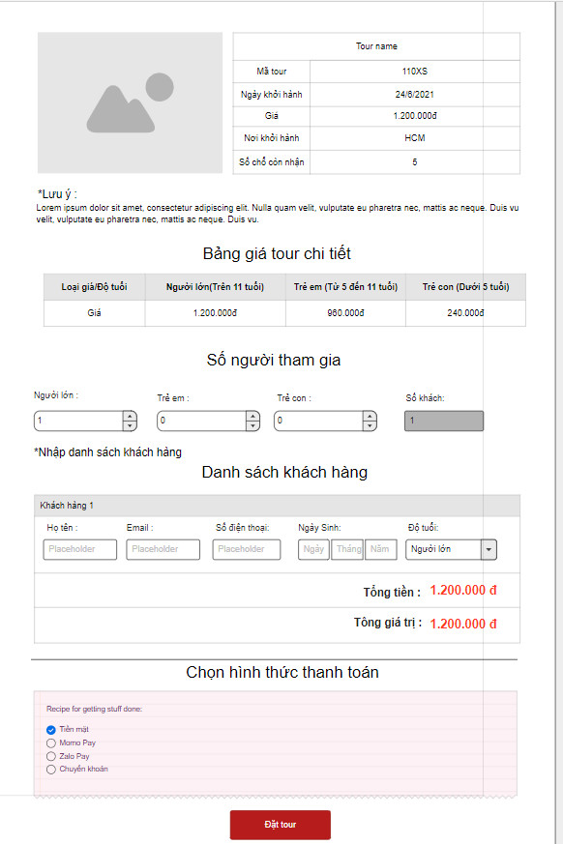
No | Description
1 | Tour information
2 | Price tour
3 | Regist tour
4 | Choose method pay
5 | Click -> payment
1
2
3
No | Table
1. | Tour
2 | Book
3. | Ticket
4 | payment-_type
4
5
Booking

Slide 11
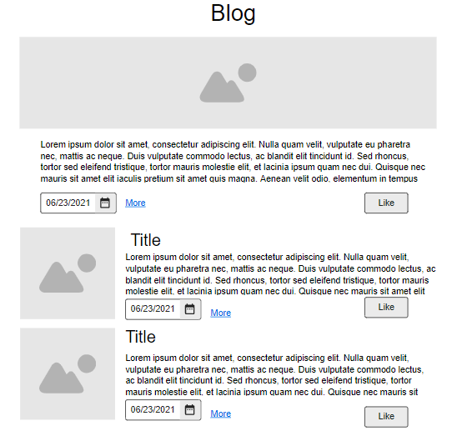
No | Description
1 | Image of blog
2 | Date upload blog
3 | Click-> blog detail
4 | Content of blog
5 | Like blog
1
4
2
3
5
No | Table
1. | Blog
2 | Like_blog
Blog

Slide 12
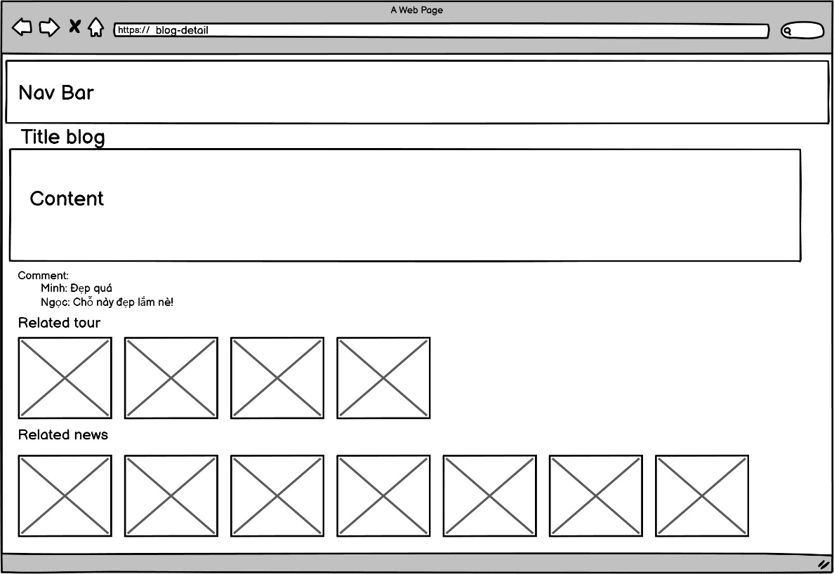
No | Description
1 | Comment of user
2 | Tour Recommend
3 | Blog Recommend
1
2
3
Blog detail

Slide 13
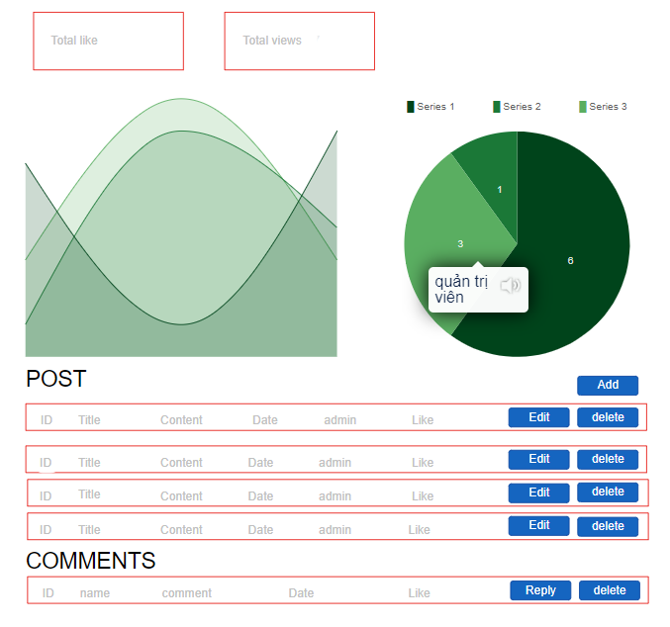
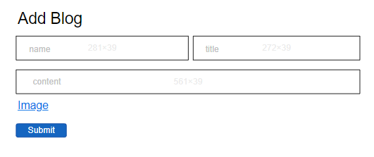
No | Description
1 | Total like of blog
2 | Total view of blog
3 | Chart
4 | Click-> redirect: add blog
5 | Edit and delete blog
6 | Manage comment
7 | Add image
8 | After fill -> click submit -> blog is added
1
2
3
4
5
6
7
Blog Admin
8

Slide 14
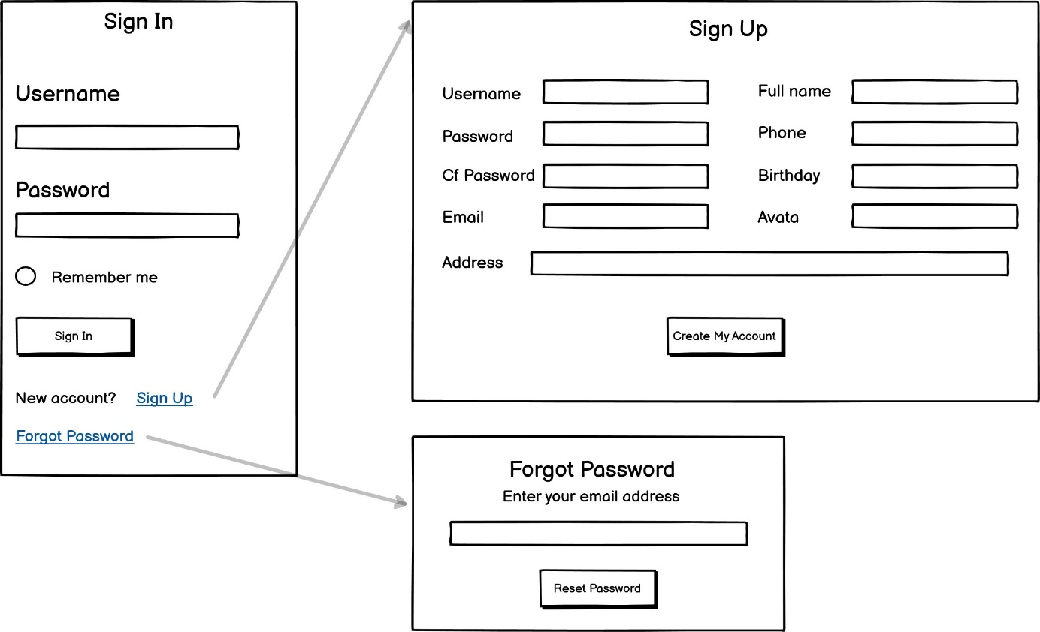
4
No | Description
1 | Remember session login
2 | After fill all field -> click button -> redirect: home
3 | If forgot password -> create new password -> fill
4 | If account not exist -> create new account-> fill all
5 | Click button-> create account-> redirect: sign in
6 | Accept new password -> redirect: sign in
1
2
5
3
6
Login

Slide 15
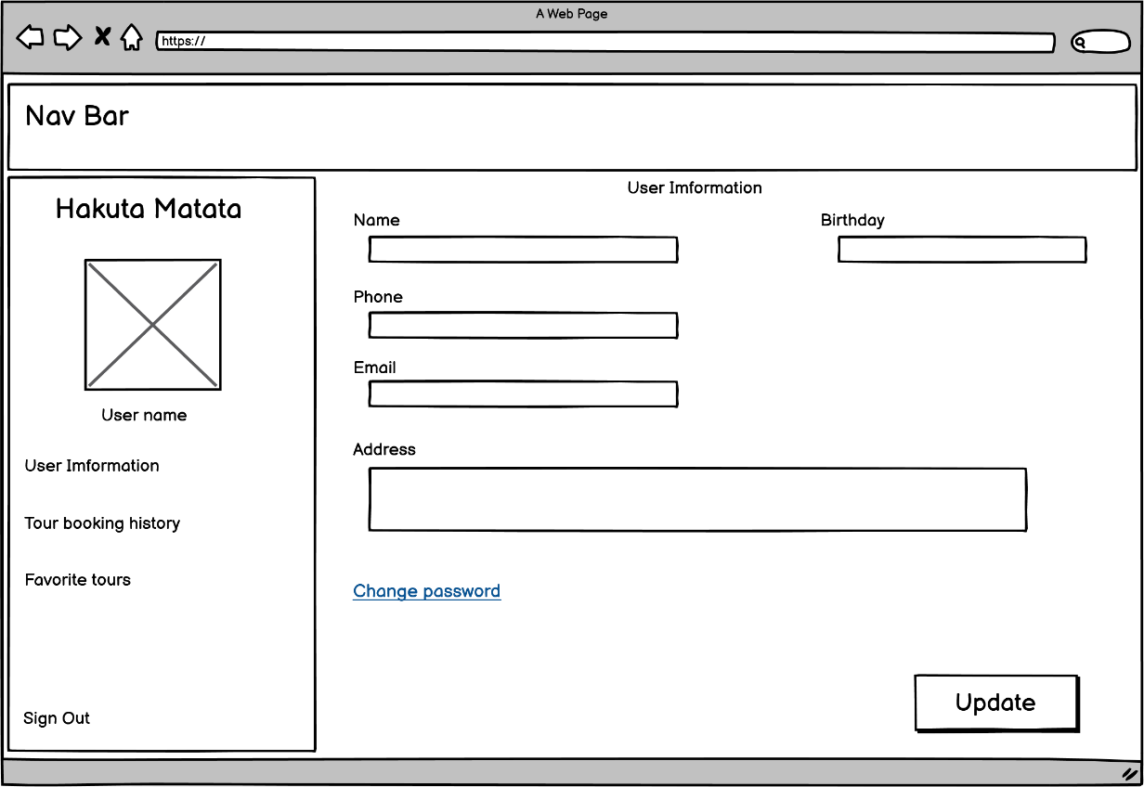
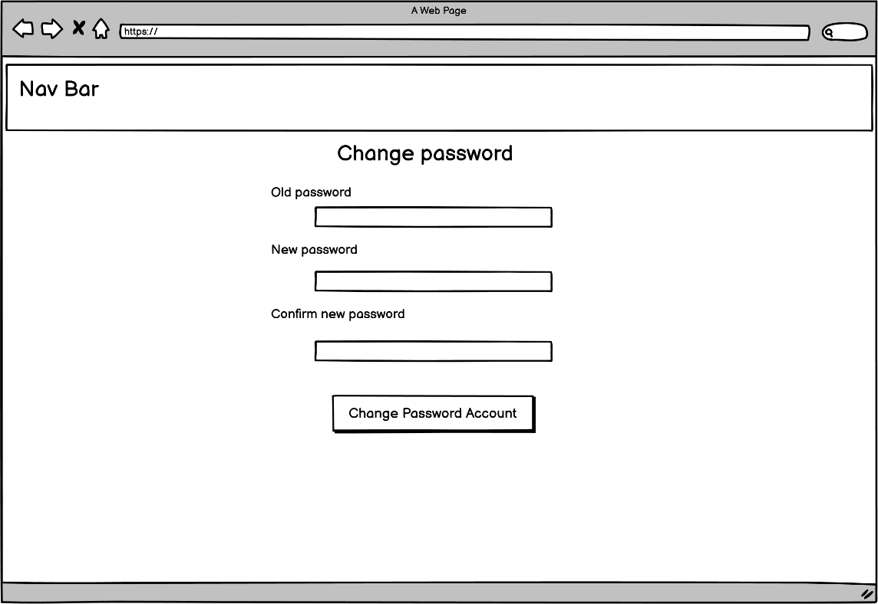
No | Description
1 | Click -> redirect: change password
2 | Click-> update field
3 | Click-> password is changed-> redirect: profile
1
2
User Profile
3

Slide 16
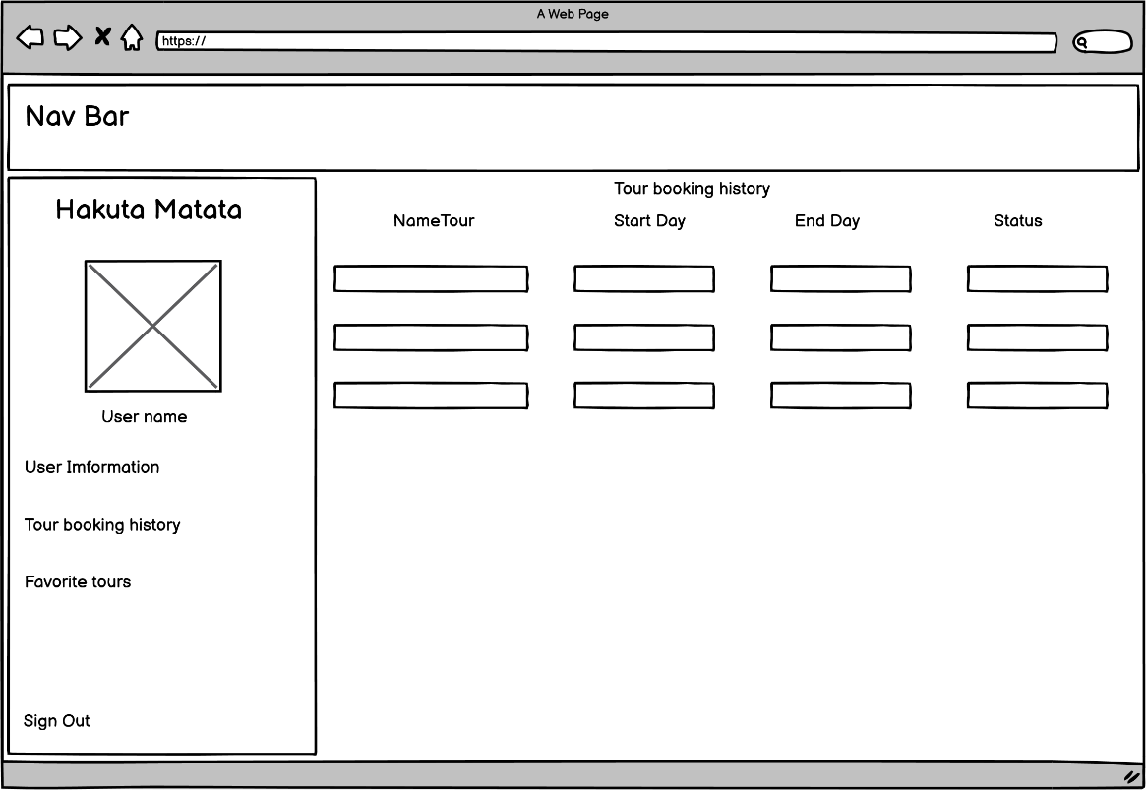
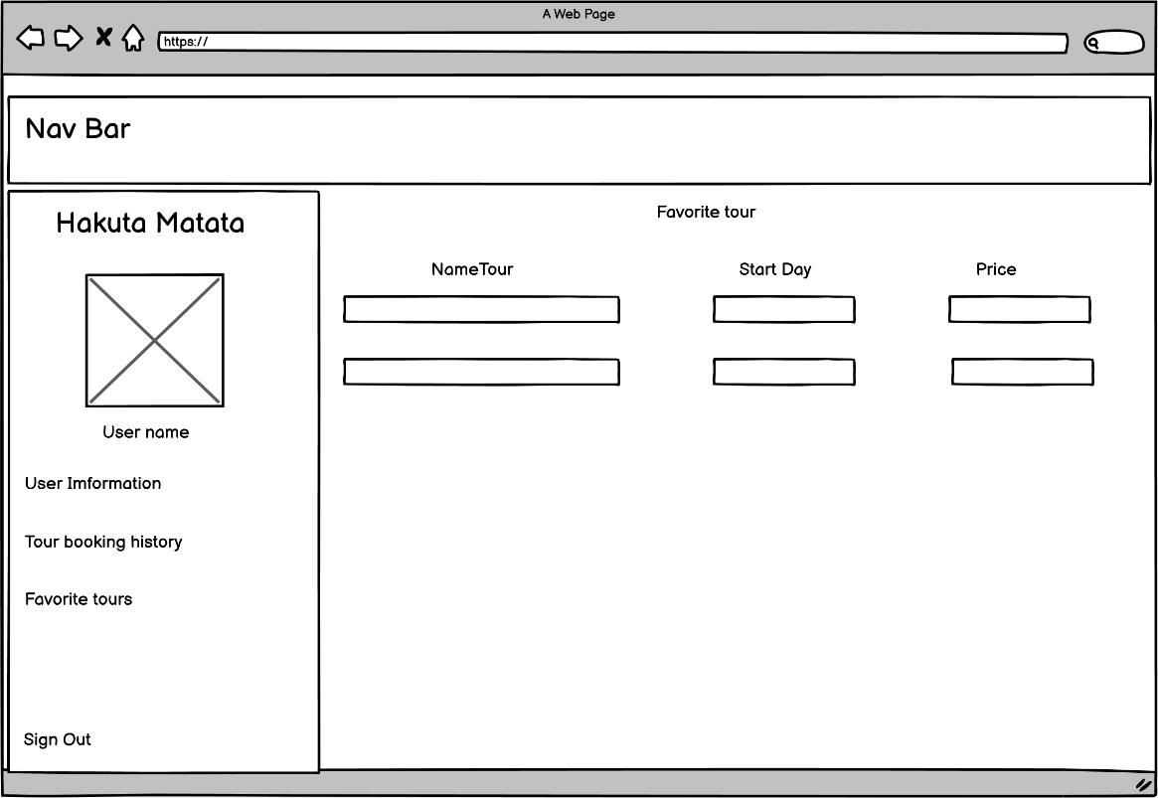
No | Description
1 | History book tour of user
2 | Favorite tour if user evaluate good-> very good
1
2
User profile

Slide 17
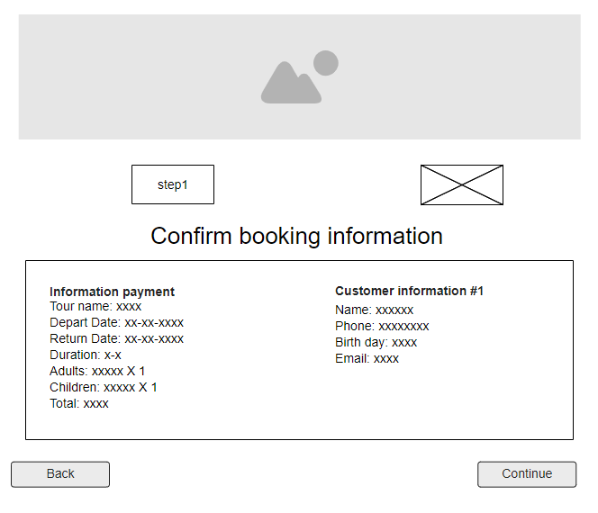
Payment Step1
No | Description
1 | Form confirm booking information – (read only)
2 | Show information payment(read only)
3 | Show personal information(read only)
4 | Back to booking page
5 | Go to payment API page
6 | Show booking process - booking3 page(read only)
6
1
2
3
4
5

Slide 18
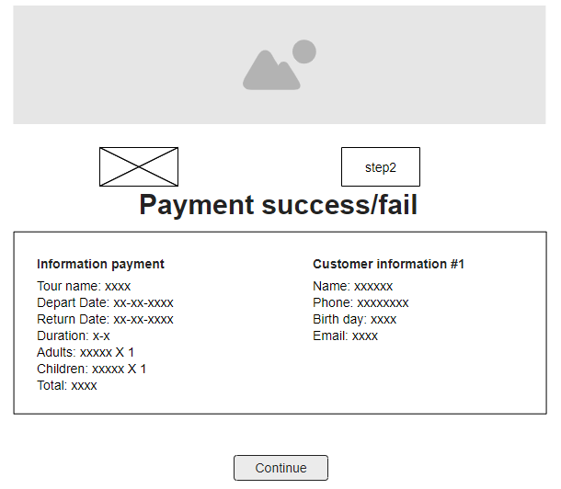
Payment Step2
No | Description
1 | Show respond payment success or fail
2 | Show information payment (only read)
3 | Show personal information (only read)
4 | Go to index page
5 | Show booking process - page booking 4(read only)
5
1
2
3
4

